Slide 1
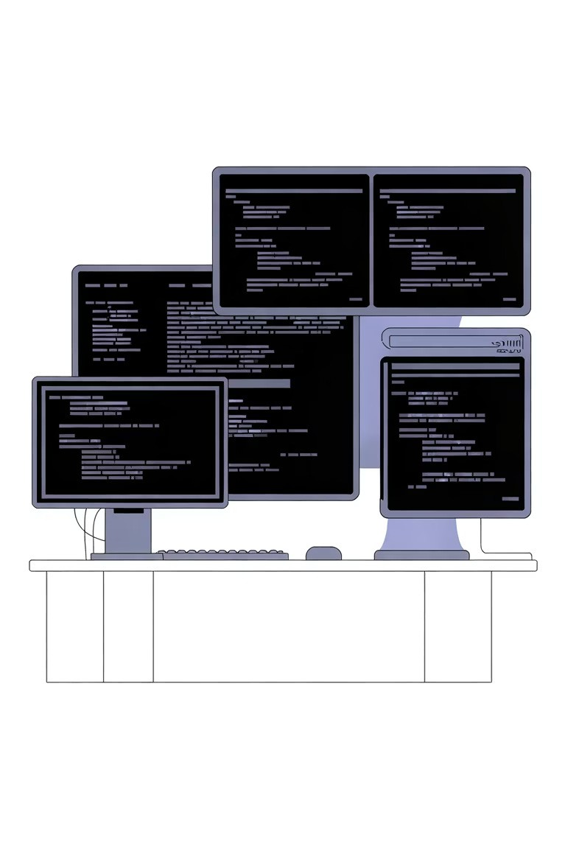

Automation Practice with Tools
Mastering Selenium, JIRA, and Bugzilla through hands-on experience

Slide 2
What We'll Cover Today
01
Tool Foundations
Understanding Selenium WebDriver, JIRA workflows, and Bugzilla bug tracking essentials
03
Real-World Examples
Live demonstrations and prototypes you can adapt for your projects
02
Practical Integration
Connecting automation frameworks with issue tracking systems for seamless workflows
04
Hands-On Practice
Interactive exercises to build confidence with each tool

Slide 3


Selenium WebDriver in Action
Core Capabilities
Selenium WebDriver enables browser automation across Chrome, Firefox, Safari, and Edge. It supports multiple programming languages including Java, Python, C , and JavaScript.
Key automation patterns:
Element location using XPath, CSS selectors, and IDs User interaction simulation (clicks, typing, scrolling) Explicit and implicit wait strategies
Screenshot capture for test evidence
Example: A typical Selenium test script automates login validation across multiple browsers simultaneously.

Slide 4




JIRA s Bugzilla Integration Workflow
Defect Discovery
Automated tests detect failures and capture detailed logs
Auto-Logging
Test frameworks create tickets in JIRA or Bugzilla with screenshots and stack traces
Track s Verify
Teams triage, fix, and re-run automated tests to confirm resolution

Slide 5
Tool Comparison: Choosing Your Stack
Selenium
Best for: Cross-browser UI testing
JIRA
Best for: Agile team collaboration
Bugzilla
Best for: Traditional bug tracking
Open-source and free
Large community support Language flexibility
Grid for parallel execution
Customizable workflows
Sprint planning tools Rich API for integrations Comprehensive reporting
Lightweight and fast
Advanced search capabilities Email notifications
Proven stability
Tip: Start with Page Object Model design pattern
Tip: Use REST API to auto-create test execution tickets
Tip: Configure custom fields for automation metadata

Slide 6
Practical Example: End-to-End Flow
Scenario: E-commerce checkout testing with automated defect reporting
Test Execution
Selenium script validates shopping cart ³ payment ³ order confirmation across three browsers
1
2
Failure Detection
Payment page timeout detected in Firefox; Selenium captures screenshot and browser logs
Auto-Ticket Creation
Python script calls JIRA API to create bug ticket with priority, environment details, and attachments
3
4
Developer Investigation
Team reviews ticket, reproduces issue using provided data, and commits fix
Regression Testing
CI/CD pipeline triggers Selenium suite; all tests pass,
ticket auto-transitions to "Verified"
5

Slide 7
Your Next Steps
Practice Daily
Commit 30 minutes to writing Selenium scripts. Start with simple login flows, then add complexity.
Build Integrations
Connect your test framework to JIRA or Bugzilla using REST APIs.
Automate ticket creation from test failures.
Share Knowledge
Document your automation patterns and share with your team. Create reusable code libraries and templates.
Remember: The best automation engineers combine technical skills with practical problem-solving. Tools are powerful, but your strategic thinking makes them effective.
Download Practice Exercises
Join Our Community

